Slide 1

SOCIAL MEDIA USER ANALYSIS
Submitted By
A. Naga Siva-23A11A0506
N. Jahnavi-25NU5A4412
V. Sri Khyathi-25NU5A4409
K. Bhavya-24NU1A4411
M. Lohith Vikram-25NU5A4412

Slide 2
CONTENTS
Abstract
Introduction
System Requirements
Architecture
Uses of data analysis libraries
Advantages
Conclusion

Slide 3
abstract
Social Media User Analysis is a data analytics project developed to study and understand user behavior on social media platforms. The project analyzes various user attributes such as age, gender, education level, daily active minutes, reels watched per day, engagement score, work hours, and stress levels.
Using Python and data analysis libraries, the dataset is processed, cleaned, and visualized to identify trends and patterns. The generated insights help in understanding user engagement and social media usage habits, making the project useful for researchers, marketers, and businesses.

Slide 4
introduction
Social media platforms have become an essential part of daily life, influencing communication, entertainment, education, and business activities. Millions of users spend significant time on platforms such as Instagram, generating large amounts of data every day.
The Social Media User Analysis project aims to analyse user behavior and engagement using data analytics techniques. By applying statistical analysis and visualization methods, the project identifies relationships between user demographics, lifestyle factors, and social media activity. The results help in understanding how users interact with social media platforms and what factors influence their engagement.

Slide 5
SYSTEM REQUIREMENTS
SOFTWARE REQUIREMENTS:
Operating System (Windows 10/11):
Provides the platform required to run the project and its software tools.
Programming Language (Python 3.x):
Python is used for data analysis, processing, and visualization.
Jupyter Notebook / VS Code:
Used to write, execute, and test Python programs efficiently.
Pandas Library:
Used for data cleaning, manipulation, and analysis.
NumPy Library:
Used for numerical and mathematical computations.

Slide 6
SYSTEM requirements
. Matplotlib Library:
Used to create graphs and charts for data visualization.
. Seaborn Library:
Used to generate attractive statistical visualizations.
. CSV Dataset:
Stores the social media user data used for analysis.
. HARDWARE REQUIREMENTS:
. IDE – Jupyter Notebook
. Storage Space –Stores project files and datasets.
Required for software installation and data storage.

Slide 7
architecture
The architecture of the Social Media User Analysis project using Python, Pandas, Matplotlib, and Seaborn involves several stages that work together to analyse and visualize user behavior data.
The process typically includes data collection, data preprocessing, exploratory data analysis, data visualization, and insight generation.
1.IMPORTING DATASET
2.DATA EXPLORATION
3.DATA CLEANING
4.DATA GROUPING
5.DATA VISUALISATION

Slide 8
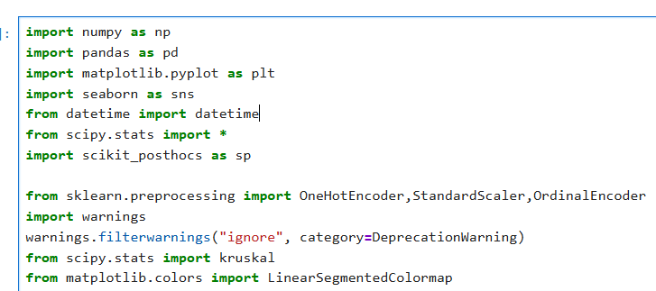

IMPORTING DATASET:
The first step is importing the required Python libraries such as Pandas, NumPy, Matplotlib, and Seaborn. These libraries provide functions for data manipulation, numerical computations, statistical analysis, and data visualization.
The social media user dataset is loaded into the Python environment using the Pandas library. The dataset, stored in CSV format, is converted into a DataFrame for easy access and manipulation. This step provides the raw data required for analysis.

Slide 9
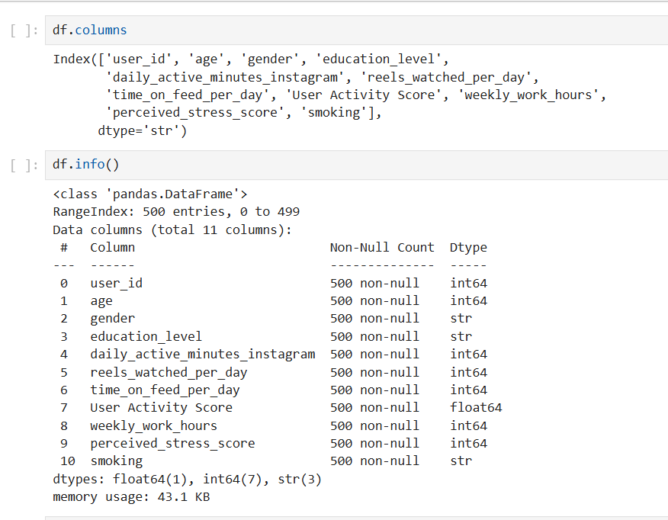
DATA EXPLORATION
Data exploration is performed to understand the structure and characteristics of the dataset. This includes examining the number of rows and columns, checking data types, viewing sample records, and generating summary statistics. Exploratory analysis helps identify important patterns, potential issues, and relationships among variables before proceeding to data cleaning and visualization
.

Slide 10
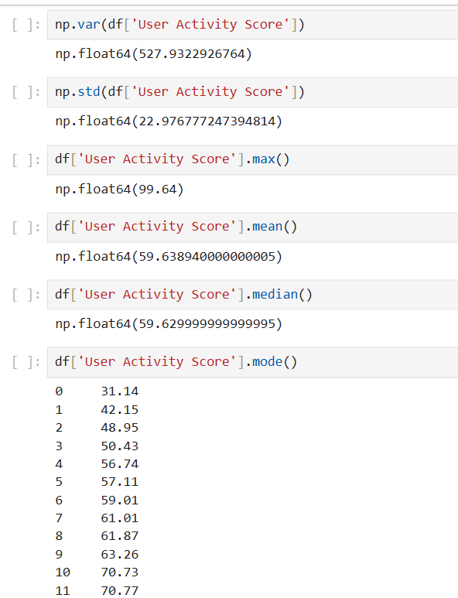
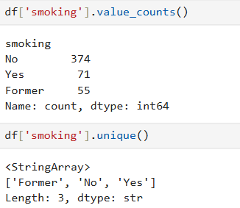
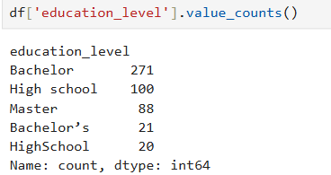
Data cleaning
Data cleaning is an essential stage that improves the quality and reliability of the dataset. Missing values, duplicate records, and inconsistent entries are identified and handled appropriately. This process ensures that the dataset is accurate, complete, and suitable for analysis. Clean data helps generate more reliable insights and improves the effectiveness of visualizations.

Slide 11
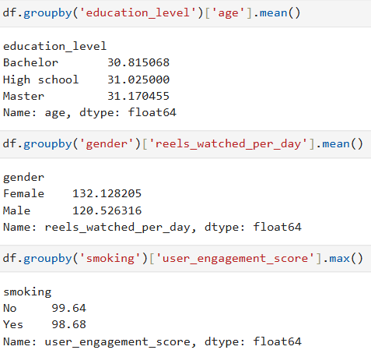
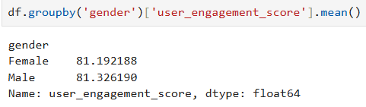
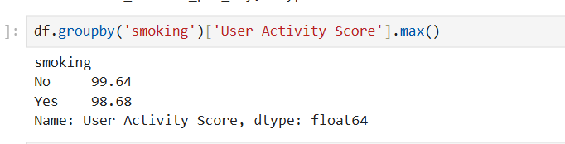
Data grouping
Data grouping is used to organize and summarize information based on specific attributes such as age, gender, education level, engagement score, and social media usage patterns. Grouping allows the project to compare different categories of users and identify trends within each group. This step simplifies complex datasets and makes the analysis more meaningful and interpretable.

Slide 12
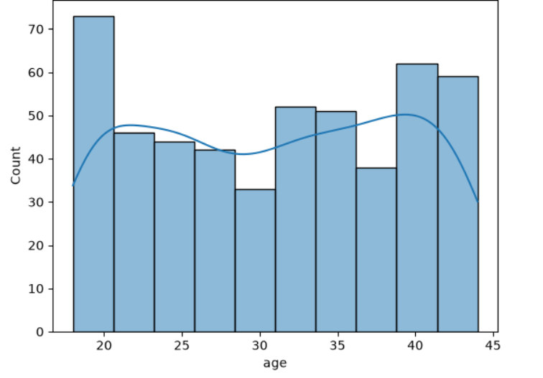
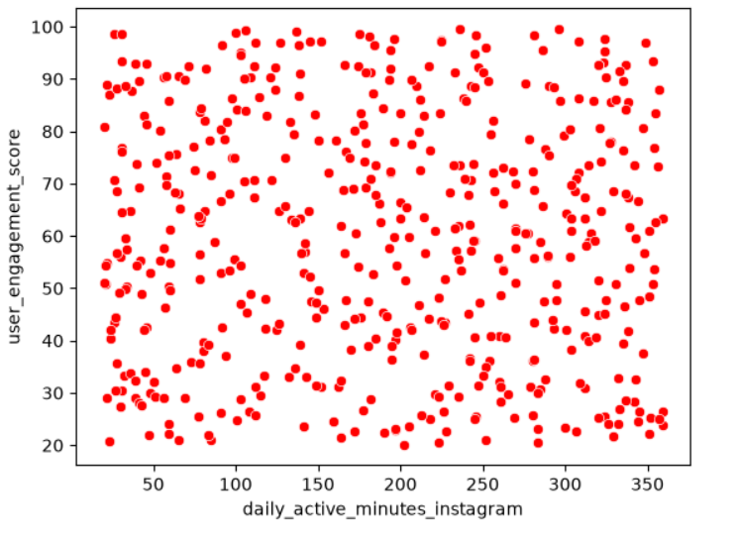
Data Visualization
Data visualization transforms numerical data into graphical representations such as bar charts, pie charts, histograms, count plots, and scatter plots. Libraries such as Matplotlib and Seaborn are used to create visually appealing and informative charts. Visualization helps identify trends, patterns, correlations, and distributions within the dataset, making the results easier to understand and communicate.

Slide 13
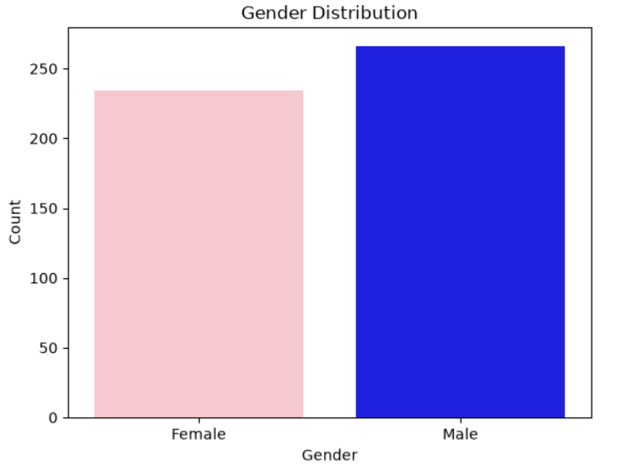
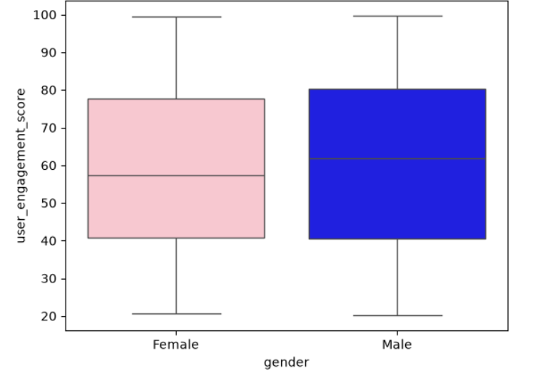
Data visualization

Slide 14
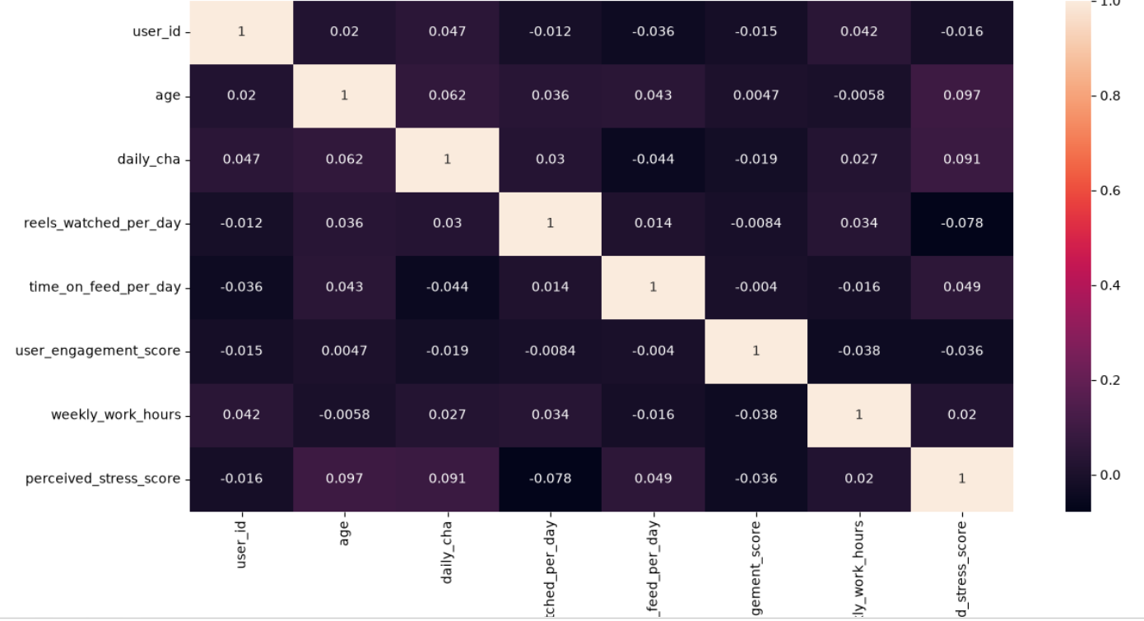
DATA VISUALIZATION

Slide 15
Uses of data analysis library
Pandas
Pandas is one of the most important Python libraries used for data analysis and manipulation. It provides powerful data structures such as DataFrame and Series that help organize data in a tabular format. In this project, Pandas is used to import the CSV dataset, inspect data, handle missing values, remove duplicate records, filter specific information, and group data based on different categories. It simplifies data preprocessing and enables efficient analysis of large datasets.
NumPy
NumPy (Numerical Python) is a fundamental library for scientific and numerical computing in Python. It provides support for multi-dimensional arrays and a large collection of mathematical functions. In this project, NumPy is used to perform numerical calculations, statistical operations, and mathematical computations efficiently. It improves processing speed and helps handle large volumes of data with better performance than standard Python data structures.
Matplotlib
Matplotlib is a comprehensive data visualization library used to create graphical representations of data. It allows users to generate various types of charts such as bar charts, line graphs, histograms, pie charts, and scatter plots. In this project, Matplotlib is used to visualize social media user behavior and engagement patterns. These visualizations help convert complex numerical data into meaningful graphical insights that are easy to understand and interpret.

Slide 16
USES OF DATA ANALYSIS
Seaborn
Seaborn is an advanced statistical visualization library built on top of Matplotlib. It provides attractive and informative graphs with minimal coding effort. In this project, Seaborn is used to create count plots, distribution plots, heatmaps, and correlation visualizations. These graphs help identify relationships between different variables such as age, engagement score, stress level, and social media usage. Seaborn enhances the overall appearance and readability of visualizations.

Slide 17
ADVANTAGES
1.Understanding User Behavior
Helps identify how users interact with social media platforms by analyzing their activity, preferences, and engagement patterns.
2. Improved Decision Making
Provides valuable data-driven insights that help researchers, businesses, and marketers make informed decisions and develop effective strategies.
3. Identifies User Activity Patterns
Analyzes factors such as active time, content consumption, and user interactions to understand engagement levels.
4. Supports Digital Marketing
Helps marketers identify target audiences, improve advertising campaigns, and increase customer engagement.
5. Data Visualization
Transforms complex datasets into clear and meaningful graphs, charts, and visual reports that are easy to interpret.

Slide 18
ADVANTAGES
6. Trend Analysis
Identifies emerging social media trends, user interests, and changing behavior patterns over time.
7. Efficient Data Processing
Python libraries such as Pandas and NumPy enable fast and accurate processing of large datasets.
8. Research and Academic Use
Useful for educational projects, social behavior studies, and research related to digital media and user interactions.
9. Business Applications
Assists organizations in understanding customer preferences, improving services, and enhancing user satisfaction.
10. Scalable and Flexible
The project can be easily extended to analyze larger datasets and data from multiple social media platforms.

Slide 19
conclusion
The Social Media User Analysis project successfully analyzes user behavior and engagement patterns using data analytics techniques. Through data preprocessing, visualization, and statistical analysis, meaningful insights are obtained regarding user activity, engagement levels, and lifestyle factors. The project demonstrates the effectiveness of Python and its data analysis libraries in extracting valuable information from large datasets. The findings can assist businesses, researchers, and digital marketers in making data-driven decisions and improving user engagement strategies.

Slide 20
Thank you

